Slide 1
Choosing the Best Snacks
Amanda Hopkins, MS, RD, LDN

Slide 2
The basics when planning your snacks
Ensure they taste good and satisfy your hunger
Must contain protein and might include some extra carbohydrates
Aim for a snack that is < 200 calories (measure portions)
Read food labels (remember <5g fat and <5g sugar rules)
Exceptions are nuts, nut butters, and milk/yogurt

Slide 3
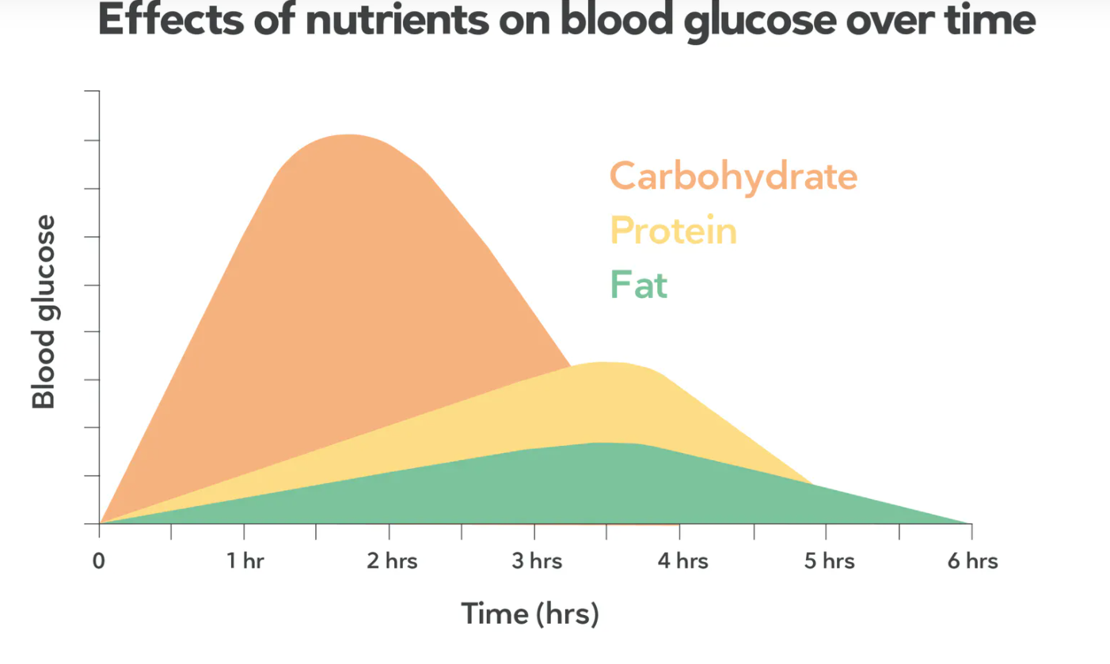
Don’t Forget to Protein-Pair
Eating a “naked carbohydrate” (i.e., fruit, crackers) causes blood sugar levels to spike then crash
You need other macros (think about proteins and healthy fats) to slow down the digestion of carbs
Protein helps you stay full for longer and have fewer sugar cravings
Helps you meet your daily protein goal

Slide 4
Benefits of Snacking
Helps you eat slightly less at meals (preventing a spike in blood sugar, heartburn, and indigestion)
Prevents you from getting too hungry at meals
Helps you keep junk food cravings at bay
Keeps energy levels maintained throughout the day

Slide 5
Low-Carb Snacks
Barely raise the blood sugar
Nuts or seeds
½ cup plain Greek yogurt + ¼ cup berries (may use stevia/Truvia to sweeten)
1 oz turkey jerky
1 oz reduced fat cheese
2 TB guacamole with fresh celery, bell pepper, or cucumber
Hard boiled egg
Deviled egg made with olive oil mayonnaise or plain Greek yogurt
Cherry tomatoes, mozzarella, fresh basil, olive oil and balsamic vinegar
Celery sticks with 1 Tablespoon peanut butter or almond butter
¼ cup raspberries + ½ cup ricotta or cottage cheese
Deli meat roll up: 1-2 oz lean deli meat rolled up with low fat string cheese

Slide 6
Moderate-Carb Snacks
Contain about 15g carbohydrates
Work well before or after exercise, since your muscles will be using up energy (blood sugar) quicker at that time)
½ cup roasted chickpeas
½ cup beans or lentils + 1 oz reduced fat cheese
1 Tablespoon peanut butter + ½ banana or 1 small apple
1 small apple + ¾ oz almonds or low fat string cheese
½ cup fresh pineapple + cottage cheese
½ cup flavored low sugar Greek yogurt
1 cup milk + ¾ oz almonds
Smoothie: ¼ cup berries, ½ cup plain Greek yogurt, 1 cup unsweetened almond milk (may use stevia/Truvia to sweeten)

Slide 7
Crispy Roasted Chickpeas
Ingredients
1 can salt-free or reduced sodium chickpeas
1 Tablespoon olive oil
Spices of your choice
Favorite combos:
½ teaspoon each of smoked paprika, cumin, garlic powder, onion powder + ¼ teaspoon salt
½ teaspoon each of curry powder, garlic powder, onion powder + ¼ teaspoon salt
¾ teaspoon cinnamon, 1 teaspoon honey, 1/8 teaspoon salt
Directions
Preheat oven to 425 degrees Farenheit
Drain chickpeas in a colander and rinse with cold water
Lay out a paper towel on the countertop and pour out chickpeas. Pat dry with an additional paper towels
Add chickpeas to a small bowel along with olive oil and desired spices. Mix with a spoon until all ingredients are well-incorporated
Lay out chickpeas on a parchment paper-lined baking sheet and place in oven for 25-35 minutes, or until desired crispness is achieved.
Makes 4 servings
Nutrition: 137 calories, 4.5g fat, 20g carbohydrate, 4g fiber, 4.5g protein

Slide 8
Demo: Crispy Chickpeas

Slide 9
Frozen Greek Yogurt Bark
Ingredients
2 cups fat free plain Greek yogurt
½ cup low sugar granola (Bear Naked or Kind brand)
½ cup berries (blueberries, chopped strawberries)
4 packets Truvia
½ teaspoon vanilla (optional)
Directions
Prepare a baking sheet by lining with parchment paper. Place Greek yogurt in a bowl and whisk together with Truvia and vanilla. Spread out the Greek yogurt mixture in an even layer onto the baking sheet. Sprinkle evenly with granola and berries. Gently pat the berries and granola into the yogurt. Freeze until very firm, at least 3 hours. Cut into 12 squares.
Serving size: 2 squares per serving for a total of 6 servings
Nutrition: 100 calories, 2.3g fat, 10g carbohydrates, 1.3g fiber, 5.6g sugar, 9.1g protein

Slide 10
Chocolate Ricotta Pudding
Ingredients
1 cup part-skim ricotta
4 oz fat free cream cheese (Great Value brand)
3 Tablespoons unsweetened cocoa powder
2 Tablespoons skim or 1% milk
3 packets Truvia
½ teaspoon vanilla (optional)
Directions
Place all ingredients into a high-speed blender or food processor. Blend until smooth. Using a spatula, distribute mixture evenly into 4 small dishes. Cover and refrigerate for at least 1 hour before serving.
Makes 4 servings
Nutrition: 103 calories, 3.1g fat, 7.6g carbohydrates, 1.3g fiber, 5.5g sugar, 10g protein

Slide 11
Conclusion
Be thoughtful about your snacks and plan ahead
Snacks can be a great tool for healthier eating
Be creative!

